Slide 1

APPLICANT CONFERENCE
Local Competition FY2026 HUD CoC Program NOFO
Treasure coast coc
(FL-509)

Slide 2


Presenters
Rayme Nuckles, MHS, MPS, SPHM
  Visionary Leader, TCHSC
Heidi Harris
  Grant and Development Coordinator, TCHSC
Susan Pourciau
  CoC Consultant

Slide 3
For today’s conference
These slides will be posted to the TCHSC website following the webinar
During our time together, please use the chat feature to submit questions or comments – we will address those at the end of the presentation
If you think of more questions later, please email cocnofo@tchelpspot.org

Slide 4



Agenda
01 | Overview of HUD CoC Program
02 | Overview of CoC Funding Available and Local Competition Process
03 | Eligible project applicants, Overarching requirements, Eligible project types, Allowable project costs
04 | How to Submit a Project Application
05 | How to Learn More
06 | Q&A

Slide 5
OVERVIEW OF HUD COC PROGRAM

Slide 6
The Basics: HUD CoC Funding
The Continuum of Care (CoC) Program
Established through U.S. Statute (the HEARTH Act)
Governed by Administrative Rules/Regulations (next slide)
Administration by the Department of Housing and Urban Development (HUD)
Each year’s HUD CoC Program Notice of Funding Opportunity (NOFO) sets forth the fundamentals of grants that may be awarded
The “Local Competition,” run by the CoC’s Collaborative Applicant (here, the Treasure Coast Homeless Services Council) determines what projects will be submitted to HUD
HUD determines which projects will be funded

Slide 7
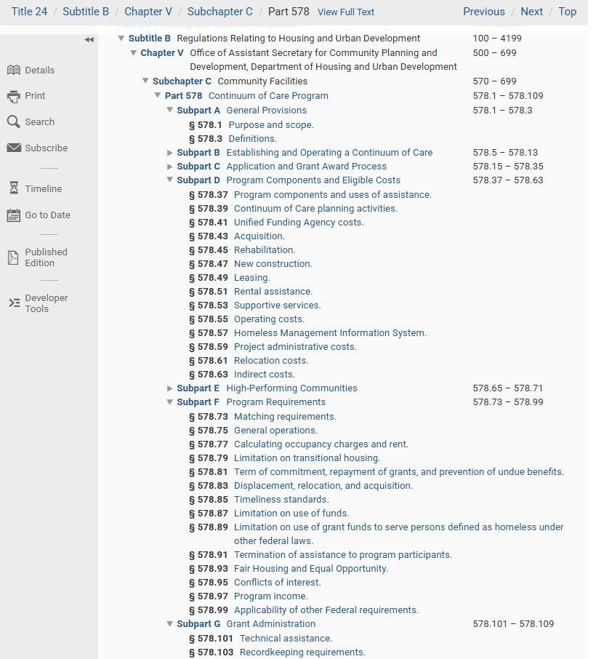
Official Program regulations
https://www.ecfr.gov/current/title-24/subtitle-B/chapter-V/subchapter-C/part-578?toc=1
Especially Subparts A, D, F, & G
This may look intimidating at first, but using the regulations is the surest way to success!

Slide 8
Additional Guidance
HUDExchange: CoC Program Toolkit
  https://www.hudexchange.info/programs/coc/toolkit/
HUD Exchange: CoC Program Requirements
  https://www.hudexchange.info/programs/coc/coc-program-eligibility-requirements/
Sign up to receive HUD CoC Program emails
  https://www.hudexchange.info/mailinglist/subscribe/ (click the “CoC” option)
Sign up to receive info from HUD about the HUD CoC funding competition
  https://www.hud.gov/subscribe/signup?listname=SNAPS%20Competitions&list=SNAPS-COMPETITIONS-L

Slide 9
OVERVIEW OF funding available & local competition process

Slide 10
Funding Possibly Available to Our CoC
BEST GUESS ONLY –
NOT YET ANNOUNCED BY HUD!!
Annual Renewal Demand (ARD) $3,300,000?
CoC Bonus Project amount $ 495,000?
DV Bonus Project amount $ 420,000?
Planning Project amount $ 165,000?
Total Possible $4,380.000?
Tier I amount $1,980,000?

Slide 11
Steps in the Local Process
Collaborative Applicant TCHSC, on behalf of the CoC, issues Request for Applications (RFA)
Project Applicants submit project applications via email to the Collaborative Applicant using the forms provided
Project Applications are reviewed, scored, and ranked by the CoC Review and Rank Committee; approved by Executive Committee
Selected projects are finalized in e-snaps and, along with the CoC Application, are submitted to HUD for consideration for funding

Slide 12
Timeline*
Date | Time | Objective
6/17/2026 | 5:00pm | Request for Applications published on TCHSC website
6/23/2026 | 10:30am | Mandatory Project Applicant Conference
7/08/2026 | 5:00pm | Project Applications due by email to cocnofo@tchelpspot.org
7/09/2026 | TBD | Mandatory training for Review and Rank Committee (RRC) members
7/10/2026 | Noon | TCHSC completes threshold review of Project Applications
7/10/2026 | 5:00pm | Project Applications distributed to RRC
7/16/2026 | Noon | RRC members submit preliminary scores to TCHSC
7/17/2026 | TBD | Review and Rank Committee (RRC) meeting
7/21/2026 | TBD | CoC Executive Committee approval of project inclusion, ranks, and funding recommendations
7/22/2026 | 5:00pm | Project Applicants notified of Executive Committee decisions
7/23/2026 | 5:00pm | Deadline to file appeal by email to cocnofo@tchelpspot.org
7/27/2026 | Noon | CoC Executive Committee decisions on appeals; approval of project inclusion, ranks, and funding requests to be submitted to HUD
7/27/2026 | 5:00pm | Project Applicants notified about appeals, final ranking and funding to be submitted to HUD
8/05/2026 | 5:00pm | Project Applicant’s submission in e-snaps due
8/14/2026 | 5:00pm | Project Applicants’ final revisions to Project Applications due in e-snaps
8/20/2026 | 5:00pm | CoC Board approves Consolidated Application to be submitted to HUD; Consolidated Application posted to TCHSC website
8/24/2026 | 10:00am | Target for CoC’s submission to HUD
8/26/2026 | 8:00pm | HUD’s Deadline for Submissions
*subject to change

Slide 13
Eligible project applicants,
Overarching requirements,
Eligible project types,
Allowable project costs

Slide 14
Eligible Project Applicants
Nonprofit organizations, including faith-based organizations
Must have 501(c)(3) certification or similar nonprofit status under IRS regulations
Must meet capacity threshold
Public Housing Authorities
Local and State governments
Tribes
Must have Federal UEI and SAM.gov registration

Slide 15
Some, not all, of the HUD CoC program requirements
All projects must serve persons who are homeless according to HUD’s definitions, in Categories 1, 2, or 4
  See Homeless Definition Chart
  Typically, does NOT include
    “Homelessness prevention” projects
    Projects serving people who are doubled-up or couch-surfing

Slide 16
Some, not all, of the HUD CoC program requirements (con’t)
Project Applicants must have the administrative capacity to operate the program
  Governance
  Staffing
  Financial systems
  Cash flow given cost reimbursement grant
  Etc.

Slide 17
Some, not all, of the HUD CoC program requirements (con’t)
All projects must participate in the CoC’s HMIS, unless DV and then must participate in comparable database (e.g., Osnium)
All projects must participate in the CoC’s Coordinated Entry System (CE) and accept CE referrals into the project

Slide 18
Some, not all, of the HUD CoC program requirements (con’t)
Project Applicants must provide a 25% cash or in-kind match for each funded project (excluding funding for “leasing” specifically)
For additional requirements, see https://www.ecfr.gov/current/title-24/subtitle-B/chapter-V/subchapter-C/part-578?toc=1

Slide 19
Eligible Project Types
New Non-DV Projects
SSO-Street Outreach (SSO-SO)
SSO-Standalone Services
Transitional Housing (TH)
Rapid Rehousing (RRH)
Permanent Supportive Housing (PSH)
HMIS – Lead Agency Only
SSO-Coordinated Entry (CE) – Lead Agency Only
New DV Projects
Transitional Housing (TH)
Rapid Rehousing (RRH)
SSO-DV Coordinated Entry
Renewal Projects
All projects on the CoC’s Grant Inventory Worksheet are eligible renewal projects
May request the same funding as last year or a reduced amount through reallocation
CoC Planning Project – Lead Agency Only

Slide 20
Supportive Services Only (SSO)
Providing supportive services to persons who are staying in unsheltered locations (e.g., encampment, vehicle, street) and those in emergency shelter, and for whom the recipient or subrecipient is not providing housing or housing assistance.
Includes Street Outreach (SO) to identify, engage, and serve those in unsheltered locations.

Slide 21
Transitional Housing (TH)
Temporary housing that includes programs to help facilitate households’ movement into permanent housing (PH).
Includes a place to live temporarily, which may be a TH facility or may be scattered site.
Includes supportive services aimed at helping households move to PH.

Slide 22
Rapid Rehousing (RRH)
Permanent housing (PH) for households for up to 24 months.
Includes renting or leasing a rental unit, such as a rental house or apartment.
Includes supportive services aimed at helping households achieve housing stability.

Slide 23
Permanent Supportive Housing (PSH)
Permanent housing (PH) that is not time-limited.
Includes renting or leasing a rental unit, such as a rental house or apartment.
Includes supportive services aimed at helping households achieve housing stability.
Households must have a disability.

Slide 24
Allowable Costs for Most Projects*
Rental Assistance
Leasing
Supportive Services
Operating Costs
Project Administrative Costs
* Note, though, that you cannot ask for all of these in any given project – different costs are allowable for different types of projects

Slide 25
In brief, rental assistance pays a household’s rent to the landlord to help the household live in permanent housing.
The lease is for at least 12 months.
The lease is between the landlord and the household (not the agency).
Rental units must meet certain requirements including “rent reasonableness” and “housing quality standards.”
Project types that typically use rental assistance are Rapid Rehousing (RRH) and Permanent Supportive Housing (PSH).
For more info, see https://www.ecfr.gov/current/title-24/section-578.51
Rental Assistance

Slide 26
When “leasing” funds are used, the lease is between the landlord and the agency (not the household).
Units leased must meet certain requirements.
Project types that typically use leasing include RRH and PSH.
For more info, see https://www.ecfr.gov/current/title-24/section-578.49
Leasing

Slide 27
Project types that typically use Supportive Services funds include Supportive Services Only (SSO) including Street Outreach, TH, RRH, and PSH.
Many types of services can be paid for, including, but not limited to:
  Case management
  Childcare
  Education
  Employment assistance
  Food
  Transportation
  Housing search
  Legal services
  Mental health services
  Substance use services
  Outreach
  Outpatient health services
  For more info, see https://www.ecfr.gov/current/title-24/section-578.53
Supportive Services

Slide 28
In brief, operating costs may be used to pay for day-to-day operating costs of a HUD CoC-funded project.
Eligible uses include
  Repair and maintenance
  Property taxes and insurance
  Utilities
  Furniture and equipment
BUT there are restrictions
  Cannot be used in a project that utilizes rental assistance
  Cannot be used to operate emergency shelter or supportive services-only facilities
Typically used for operating costs of TH facilities or leasing-type PH projects
For more info, see https://www.ecfr.gov/current/title-24/section-578.55
Operating

Slide 29
Up to 10% of the project funding can be used for Admin associated with the project.
Eligible uses include
  General management and oversight, such as accounting and project evaluation
  Training
For more info, see https://www.ecfr.gov/current/title-24/section-578.59
Project Administrative Costs

Slide 30

How to submit a project application

Slide 31
Steps in Process
Determine if you are an eligible Project Applicant and have the capacity to administer the funding if awarded
Determine what eligible Project Type you want to request and the approximate amount of funding you will request
Choose the correct Project Application from the website
Complete the Project Application AND, if a new project, the Budget Form
Submit the Project Application and Budget by email by the deadline
If selected for inclusion in the local competition, complete Project Application in e-snaps*
*Note: If you are not a current e-snaps user, go ahead and get signed up for that system ASAP and begin entering data as early as possible! (It’s not easy)

Slide 32
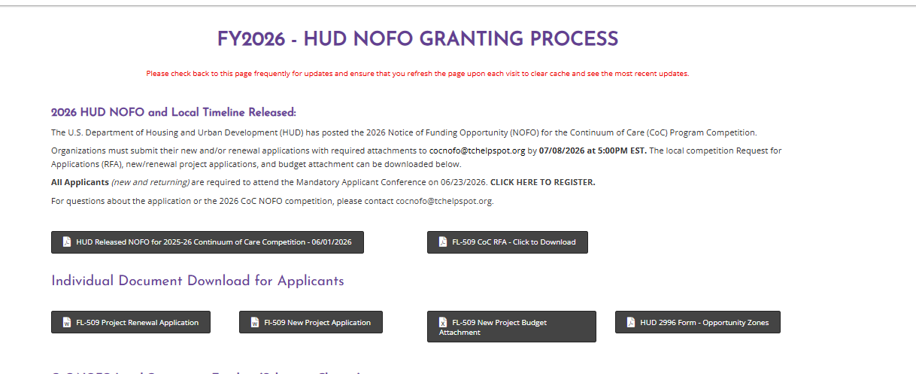
Competition Materials: Link at https://tchelpspot.org/2026-hud-nofo/

Slide 33
Request for Applications

Slide 34
Renewal Projects

Slide 35
New Projects

Slide 36
Heads Up About Threshold Criteria
In the New Project Application, you will see certain questions that are in italics – these reflect HUD’s threshold criteria
  Example: TH projects must have a plan in place to ensure that at least 50% of participants exit to a positive destination and at least 50% of participants exit with employment income
If your Project does not meet HUD’s threshold criteria, it will be rejected outright in the local competition!!

Slide 37
Avoid These Common Errors
Do not submit more than one project per application
  submit a separate application for each project
Do not propose more than one project type per project
  project types are exclusive so you can’t, for instance, submit a project that is for both street outreach and transitional housing
Do not complete sections of the application that don’t apply to your project
  for instance, if you are proposing a TH project, do not answer questions in the RRH section
Do not leave blank the parts of the project application that apply to your project
  for instance, don’t forget to respond to the “All Projects” section or fail to answer questions

Slide 38
Avoid These Common Errors (con’t)
Do not submit a budget that doesn’t make sense in terms of your project description
  for instance, if your project is going to serve 15 individuals, it doesn’t make sense to have two case managers’ salaries in your budget
Do not submit inconsistent information in your application
  for instance, if on your project application you say you’re requesting $500,000, do not submit a budget for $300,000
Do not submit a budget that includes costs that are not allowable for your specific project type
  for instance, rental assistance and operating costs in the same budget

Slide 39

How to learn more

Slide 40
Links to Resources
All kinds of important info about the CoC’s local competition:
  https://tchelpspot.org/2026-hud-nofo/
FY2026 HUD CoC NOFO
  https://www.hud.gov/sites/dfiles/CPD/documents/CoC/FY2026-CoC-Program-NOFO.pdf
HUD’s CoC Competition Landing Page
  https:/www.hud.gov/hud-partners/community-coc
HUD’s e-snaps Toolkits and Other Resources
  https://www.hudexchange.info/programs/e-snaps/
The e-snaps Online Grant Application System
  https://esnaps.hud.gov/grantium/frontOffice.jsf

Slide 41
Contact Emails
Any and all questions (local)
cocnofo@tchelpspot.org
Assistance with e-snaps and CoC funding rules (local)
pourciau.susan@gmail.com
Assistance with HUD CoC Program NOFO (HUD)
CoCNOFO@hud.gov
Assistance with e-snaps (HUD)
E-snaps@hud.gov

Slide 42
Q&A

