Slide 1
Applicant conference
FL-509 Continuum of Care
2024 HUD CoC NOFO
Local Competition

Slide 2
CoC competition Team
Rayme L. Nuckles, MHS, MPS, SPHM, Visionary Leader, TCHSC
Leigh Anne Uribe, Director of Programs, TCHSC
Heidi Harris, Grant and Development Coordinator, TCHSC
Susan Pourciau, Consultant
Penny Dietzen, Director of Data and System Performance, TCHSC
Email for all things CoC Competition: cocnofo@tchelpspot.org

Slide 3
for today’s conference
These slides will be posted to the TCHSC website following the webinar
During our time together, please use the chat feature to submit questions or comments – we will address those at the end of the presentation
If you think of more questions later, please email cocnofo@tchelpspot.org

Slide 4
Overview

Slide 5
Hud coc nofo 2024 resources/links
HUD CoC NOFO
HUD Continuum of Care Program Competition Page
HUD Continuum of Care Program Overview (including guidance about eligibility and program requirements)
24 CFR 578 (the federal regulations governing the CoC program)
E-Snaps Information Page (to help you use the online grant application system for HUD CoC funding)

Slide 6
FL-509 Local competition resources
Link to FL-509 Local Competition Documents

Slide 7
Big Picture Overview of Funding Process
HUD releases Notice of Funding Availability (NOFO)
TCHSC releases Request for Applications (RFA) for renewal and new projects
TCHSC submits full application to HUD
Review and Rank Committee and CoC Exec Committee select and rank projects to be included in submission to HUD
HUD selects projects for funding

Slide 8
FL-509 Funding available (not yet announced)
Renewal Demand $
CoC Bonus $
DV Bonus $
CoC Planning $
Total Available $
Tier 1 Amount $

Slide 9
Selected Requirements for Funding
Project applicant must:
Have administrative capacity and governance structure adequate to administer federal funding
Provide match (cash or in-kind) of at least 25% of funding request
Participate fully in HMIS (or comparable database, if a DV provider)
Participate fully in Coordinated Entry
Implement programs with high fidelity to Housing First principles and practices
Implement programs using best practices expected by HUD (e.g., trauma informed, participant-centered, racial equity, inclusive of perspectives of people with lived experience)
Comply with HUD’s Equal Access and Gender Identity Rules (i.e., requirements around LGBTQ+ identities)
Cooperate with project monitoring conducted by TCHSC and HUD

Slide 10
More about Housing First
“Housing First is a flexible and adaptable service model that addresses homelessness by quickly placing [households] experiencing homelessness into housing without any preconditions or barriers and offering voluntary supportive services to meet individuals’ needs. (source: HUD’s Housing First Evidence)
Housing First is one of HUD’s top priorities for CoC projects
Low barriers to entry and low ongoing program requirements
To enter, and continue in, program and housing, participant cannot be required to be clean and sober, employed, have income, comply with substance use or mental health recommendations or treatment, etc.
Commitment to Housing First will be scored in application process
Implementation will be monitored by TCHSC

Slide 11
Eligible project types
Rapid Rehousing (RRH) – new and renewal
Permanent Supportive Housing (PSH) – new and renewal
DV-focused Rapid Rehousing – apply for DV Bonus
DV-focused Coordinated Entry – apply for DV Bonus
HMIS, Coordinated Entry, and CoC Planning – TCHSC only
For more info on these terms, refer to the HUD NOFO and visit this HUD resource

Slide 12
What type of projects CANNOT be funded with HUD CoC funds?
Outreach
Emergency shelter
Transitional housing
Programs for people who do not meet HUD’s definition of “homeless” under categories 1, 2, or 4 (see this link), such as
Youth in foster care
People who are unstably housed and need homelessness prevention assistance

Slide 13
Rapid Rehousing (RRH)
Intended to quickly house households in a rental unit and provide services to help the household maintain stable housing; households must be referred by Coordinated Entry
Rental assistance (or leased unit)
Project application annual budget defaults to 12 months of 100% rental assistance
Rental assistance may be provided for up to 24 months total
Unit must meet HUD’s Housing Quality Standards (HQS)
Rent must meet rent reasonableness requirements; budget is based on HUD’s Fair Market Rents (FMR)
Supportive services, such as case management
Admin of up to 10% of requested funding

Slide 14
Permanent Supportive Housing
Intended to quickly house households in a rental unit and provide services to help the household maintain stable housing
Program participants must be referred by Coordinated Entry and must have a disabling condition
Rental assistance (or leased unit)
Project application annual budget defaults to 12 months of 100% rental assistance
Rental assistance has no time limit
Unit must meet HUD’s Housing Quality Standards (HQS)
Rent must meet rent reasonableness requirements; budget is based on HUD’s Fair Market Rents (FMR)
Supportive services, such as case management
Admin of up to 10% of requested funding

Slide 15
Process and Timeline
Request for Applications released | 8/07/2024
Mandatory Applicant Conference for all project applicants | 8/12/2024
Mandatory training for Review and Rank Committee (RRC) | 8/21/2024
Applications due to cocnofo@tchelpspot.org by 4:00pm on 8/30/2024 | 8/30/2024
Applications provided to Review and Rank Committee (RRC) | 9/03/2024
RRC preliminary scores due to TCHSC | 9/11/2024
Review and Rank Committee meeting | 9/16/2024
CoC Executive Committee meeting for final approval of project inclusion and ranks | 9/20/2024
Applicants notified about project inclusion and ranks | 9/20/2024
Appeals due to cocnofo@tchelpspot.org | 9/24/2024
CoC Executive Committee decisions on appeals; all applicants notified | 9/26/2024
Projects due in e-snaps for review by TCHSC staff | 10/07/2024
Deadlines for corrections (as identified by TCHSC staff) in e-snaps | 10/11/2024
CoC Consolidated Application public posting | 10/25/2024
CoC Consolidated Application submission to HUD | 10/28/2024

Slide 16
Renewal projects

Slide 17
Renewal project applications
To renew existing HUD CoC-funded projects
Download application from website
Submit to cocnofo@tchelpspot.org before 4:00pm on August 30

Slide 18
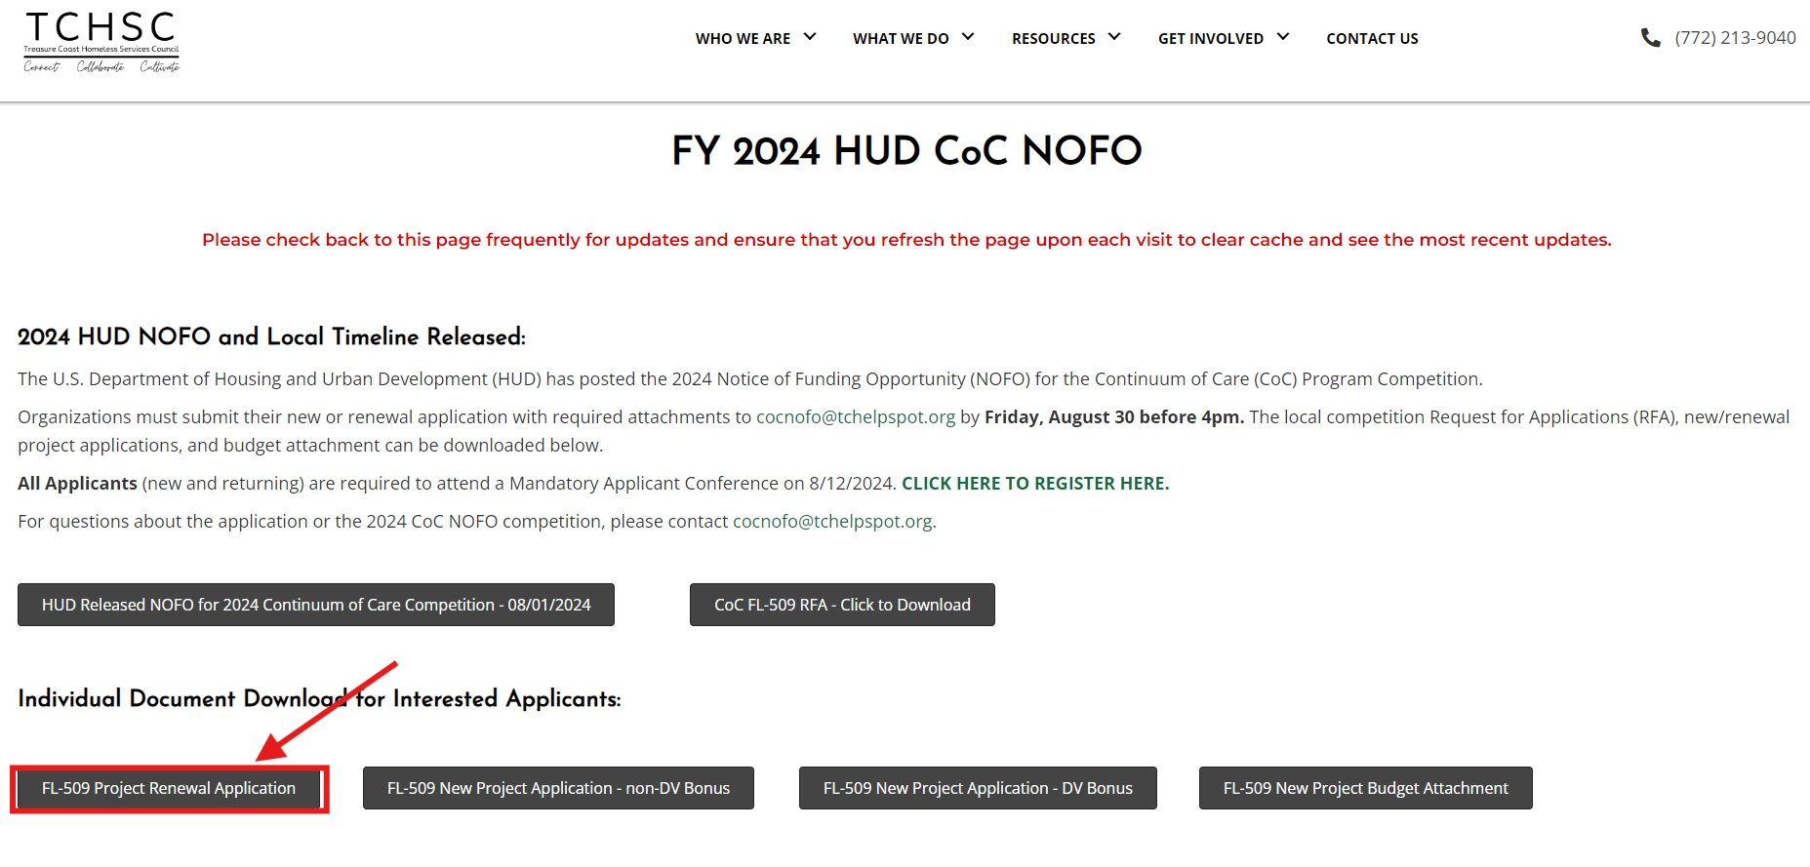

Slide 19
Renewal project scoring
Racial Equity | 10
Timely Drawdowns and Recaptured Funds | 20
Project Performance | 70
Total | 100
Detailed Scoring Tool included in RFA

Slide 20
New projects

Slide 21
new project application
To request funding for a new project proposed for HUD CoC funding or an expansion of an existing HUD CoC-funded project
Two types of New Project Applications – choose the right one!
New DV Bonus Project Application
New Project Application other than DV Bonus Project
Both non-DV and DV applications must utilize the provided budget worksheet.
Download application and budget attachment from website
Submit to cocnofo@tchelpspot.org before 4:00pm on August 30

Slide 22
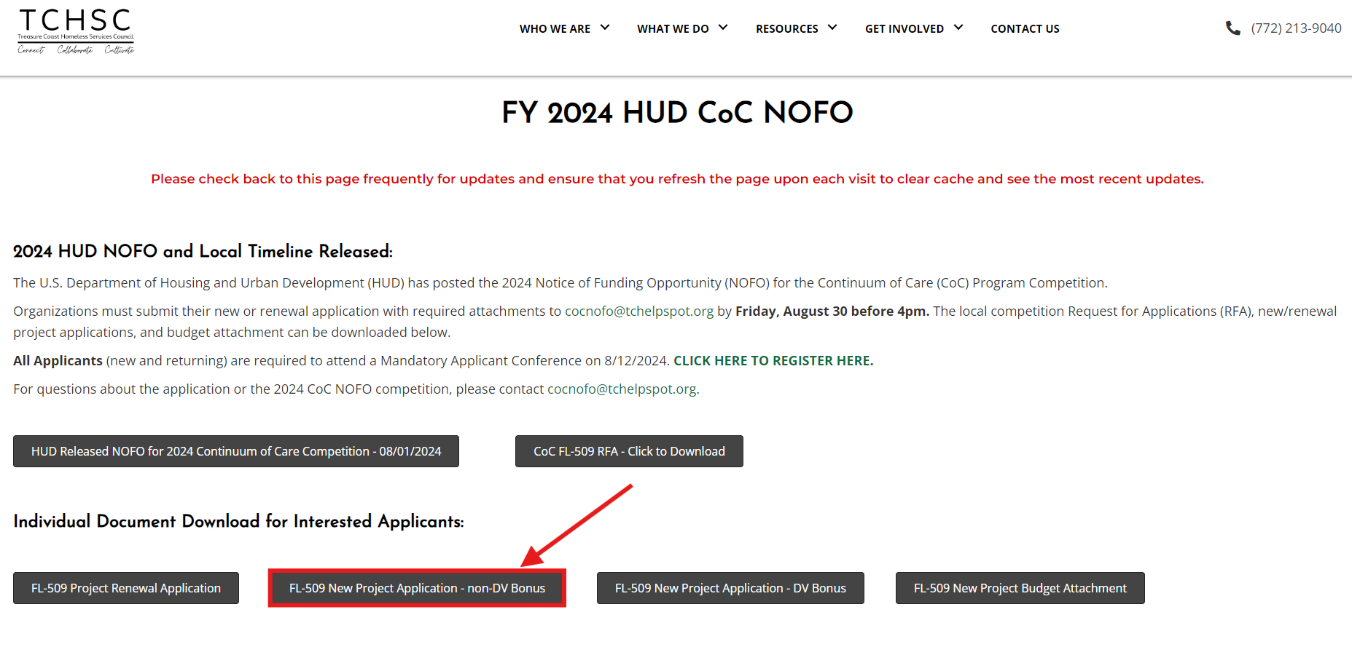

Slide 23
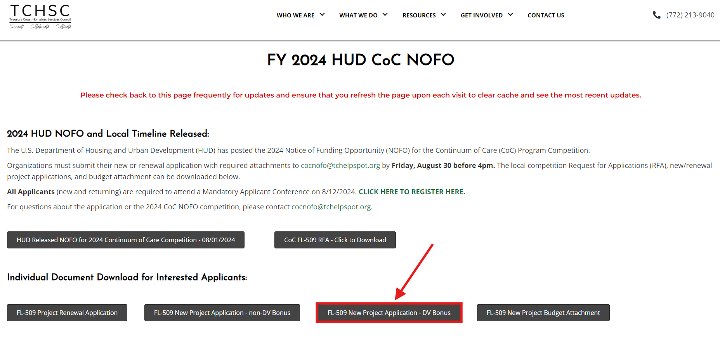

Slide 24
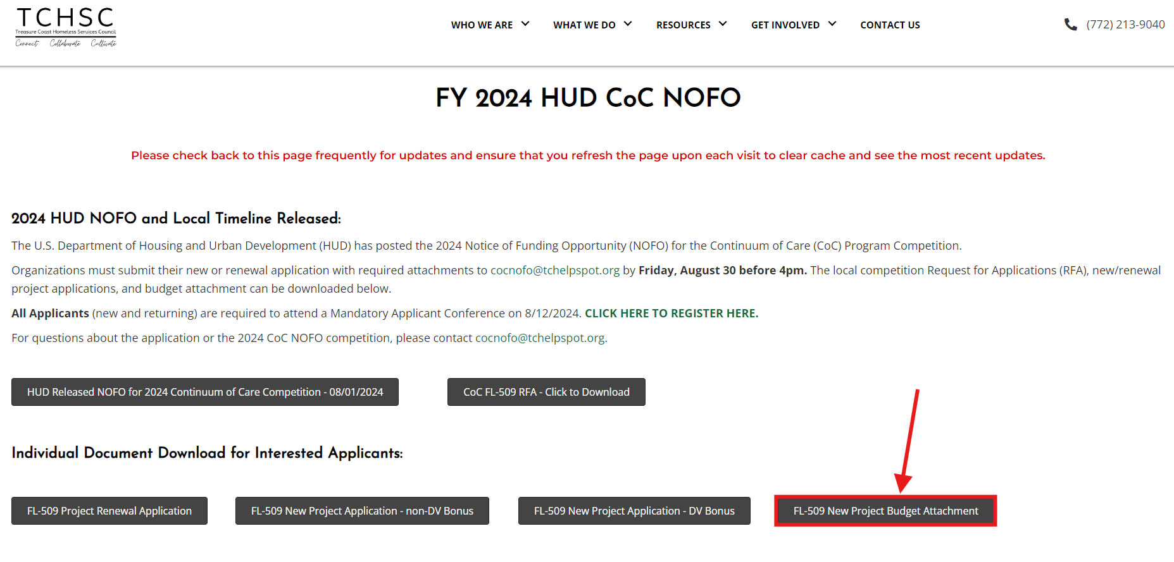
New applications (both DV and Non-DV) must utilize the same budget template.

Slide 25
DV Bonus scoring tool
Section | RRH | CE
Organizational Capacity | 8 | 8
Overall Project Design | 21 | 21
Program Design | 12 | 25
Expected Performance | 43 | 40
Budget | 6 | 6
Housing First | 10 | -
Total | 100 | 100
Detailed Scoring Tool included in RFA

Slide 26
New project scoring tool (non-dv)
Organizational Capacity | 15
Project Design | 26
Expected Performance | 43
Budget | 6
Housing First | 10
Total | 100
Detailed Scoring Tool included in RFA

Slide 27
Process following your applications

Slide 28
Review, Scoring, Ranking
The Review and Rank Committee will use the published scoring tools to score each project application – including renewals and new projects
The Review and Rank Committee will determine:
Projects to be rejected
Projects to be submitted to HUD but at an amount less than the amount requested by the project applicant, which may include reallocating funding from existing projects
Projects to be submitted to HUD at the amount requested by the project applicant.
Ranks of each project to be submitted to HUD, apart from the CoC Planning grant, which is not subject to ranking as required by HUD
There is an appeals process outlined in the Request for Applications

Slide 29
E-snaps Project submission
If your NEW project is accepted by the CoC through the Review and Rank process and approved by the CoC Executive Committee . . .
You must then enter project information into the HUD CoC Program online grant system, called e-snaps.
Here are resources to help you: e-snaps toolkit
You may also request support from TCHSC or our consultant by emailing cocnofo@tchelpspot.org
Your project must be submitted in e-snaps by 4:00pm on 10/07/2024
TCHSC will review and may request revisions to your e-snaps submission; corrections are due by 10/11/2024

Slide 30
E-snaps Project submission
All RENEWAL projects accepted by the CoC through the Review and Rank process and approved by the CoC Executive Committee . . .
Will be uploaded and submitted into e-snaps by TCHSC staff.
TCHSC staff may reach out to your agency for more information if revisions/updates are required.
Your renewal project will be submitted in e-snaps by 4:00pm on 10/07/2024

Slide 31
E-snaps submissions
Completed projects in e-snaps that are accepted for inclusion in the CoC’s Consolidated Application will be submitted to HUD by TCHSC
TCHSC will submit the following to HUD, as required by the NOFO, on or before October 30, 2024
New and renewal projects as entered into e-snaps
Project priority (ranked) list
CoC Application

Slide 32
Questions?

