Slide 1
CONNECT
COLLABORATE
CULTIVATE
2024
POINT
IN
TIME
TRAINING
Treasure Coast Homeless Services Council
Presented By:
Bruce Cady Penny Dietzen
Director of Operations Director of Data & Sys. Perf.
bruce@tchelpspot.org
2525 St. Lucie Ave
Vero Beach, FL 32960
www.tchelpspot.org
772.213.9040 X 1015

Slide 2
PURPOSE OF THE
POINT-IN-TIME COUNT (PIT)
Across the nation, every Continuum of Care (COC) conducts a PIT Count during the month of January. This is an important annual benchmark that serves as an indicator of progress, needs, and gaps within our CoC. PIT Count data is reported directly to the Department of Housing and Urban Development (HUD), Congress, the State of Florida, and local jurisdictions.

Slide 3
DEFENITION:
UNSHELTERED HOMELESSNESS
Those who are sleeping in a place that is not intended for human habitation.
The below are NOT “Unsheltered” Homeless:
Couch Surfers (staying with friends or family)
Hotel paid by individual
Individuals and families in shelters
Those living in RV’s by choice *
*Except those cases where the RV is in disrepair, unfit for human habitation, etc. use judgement

Slide 4
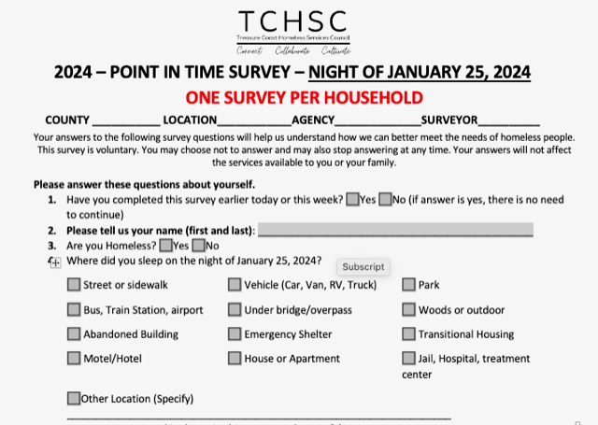
PIT 2024: SURVEY

Slide 5
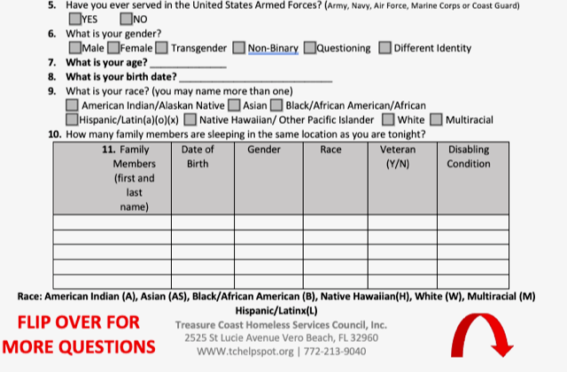
PIT 2024: SURVEY

Slide 6
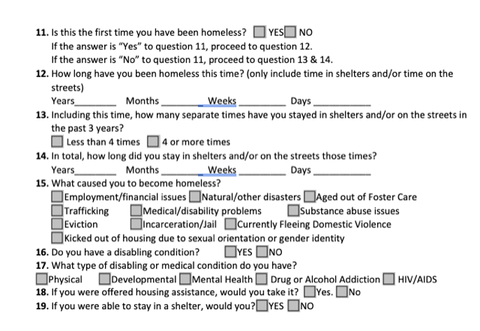
PIT 2024: SURVEY

Slide 7
PIT 2024:
THE STREET COUNT BASICS
Field Interviews
Office & Phone Interviews
Teams of 2-3 Surveyors go to areas where those experiencing homelessness are. Surveys are completed for each individual or household.
Homeless service providers and outreach organizations conduct surveys with clients who present themselves for services.
Where did you sleep the night of January 24, 2024?

Slide 9
PIT 2024: DO‘S AND DON’TS
DO
DON’T
Say your name
Say the name of the Treasure Coast Homeless Services Council or the organization you are counting for
Briefly explain the purpose of the survey
Explain that participation is voluntary
Explain that they can end the survey at any time
State that the survey is confidential
Start the conversation by asking if someone is homeless
Promise that they will be connected with any specific service or housing if they participate
Mandate participation
Proceed with the survey until you’ve gotten verbal consent

Slide 10
PIT 2024:
SAFETY CONSIDERATIONS
DO
DON’T
Always work in teams
Be respectful of space
Ask a person to participate if you think they are homeless
Introduce yourself and explain what you are doing
Be sincere and caring
Remain Calm
Know how to de-escalate
Know emergency numbers
Honor requests to not participate
Provide shelter information if possible
Dress appropriately
Wake up someone
Approach if you don’t feel comfortable
Invade personal space
Give money or offer rides
Share any confidential info or photos of participants
Put anyone in danger

Slide 11
IF YOU ENCOUNTER AN EMERGENCY OR FEAR FOR YOUR SAFETY
CALL 911

Slide 12
PIT 2024:
WHAT TO BRING in the field
Comfortable Clothing
Flashlight
Bug Spray
Clip Board
And a positive
attitude!

Slide 13
PIT 2024: SCHEDULE
REMEMBER…
We are counting those experiencing homelessness
the night of January 25, 2023
START
END
Thursday January 25, 2024
12:00 NOON
Friday January 26, 2024
12:00 NOON
Weather Forecast:

Slide 14
PIT 2024: NEXT STEPS
Volunteers that are not part of a pre-assigned agency group will be contacted and asked which shift they would like to volunteer for:
Shift 1
1/25/2024
Shift 2
1/25/2024
Shift 3
1/26/2024
Shift 4
1/26/2024
12:00 PM
to
4:00 PM
4:00 PM
to
8:00 PM
5:00 AM
to
9:00 AM
9:00 AM
to
12:00 PM
DETAILS ON LOCATION TO START SHIFT WILL BE PROVIDED 1-DAY PRIOR TO THE PIT COUNT

Slide 15
PIT 2024: LIVE SUPPORT
During Hours of PIT
12:00 NOON - Thursday January 25, 2024
TO
12:00 NOON - Friday January 26, 2024
CALL
772-213-9040 x 3032
For general questions, need support from TCHSC, need more surveys, etc.

Slide 16
PIT 2024: KEY STAFF
Bruce Cady
Susan Ketterer
Director of Operations
PIT Outreach Volunteer
772-213-9040 x 1015
772-213-9040 x 3032
CONTACT NUMBERS WILL BE PROVIDED THE DAY OF THE PIT

Slide 17
QUESTIONS?

