Slide 1
Applicant conference
FL-509 Continuum of Care
2023 HUD CoC NOFO
Local Competition

Slide 2
CoC competition Team
Rayme L. Nuckles, MHS, MPS, SPHM, Visionary Leader, TCHSC
Heidi Harris, Grant and Development Coordinator, TCHSC
Susan Pourciau, Consultant
Penny Dietzen, Director of Data and Systems Performance, TCHSC
Rich Boozell, HMIS Systems Manager, TCHSC
Email for all things CoC Competition: cocnofo@tchelpspot.org

Slide 3
for today’s conference
All participants are muted
These slides will be posted to the TCHSC website following the webinar
During our time together, please use the chat feature to submit questions or comments – we will address those at the end of the presentation
If you think of more questions later, please email cocnofo@tchelpspot.org

Slide 4
Today’s objectives
Introduce new processes
Provide direction
Answer questions

Slide 5
Overview

Slide 6
Hud coc nofo 2023 resources/links
HUD CoC NOFO
HUD Continuum of Care Program Competition Page
HUD Continuum of Care Program Overview (including guidance about eligibility and program requirements)
24 CFR 578 (the federal regulations governing the CoC program)

Slide 7
FL-509 Local competition resources
Link to FL-509 Local Competition Documents

Slide 8
FL-509 Funding available (not yet announced)
Renewal Demand $
CoC Bonus $
DV Bonus $
CoC Planning $
Total Available $
Tier 1 Amount $

Slide 9
Applicant threshold requirements
Eligible project applicants: nonprofit organizations and local governments
Nonprofits must have an active Unique Entity ID # (formerly DUNS) and Sam.gov registration
Must have a Code of Conduct on file with HUD or submit with the project application
Fully participate in HMIS and Coordinated Entry (or, if a DV provider, a comparable system)
Administrative capacity to carry out HUD-required activities

Slide 10
Eligible project types
Rapid Rehousing (RRH) – new and renewal
Permanent Supportive Housing (PSH) – new and renewal
DV-focused Rapid Rehousing – apply for DV Bonus
DV-focused Coordinated Entry – apply for DV Bonus
HMIS, Coordinated Entry, and CoC Planning – TCHSC only
For more info on these terms, refer to the HUD NOFO and visit this HUD resource

Slide 11
Process and Timeline
Request for Applications released | 7/14/2023
Mandatory Applicant Conference for all project applicants | 7/24/2023 at 2pm
Mandatory training for Review and Rank Committee (RRC) | 7/28/2023 at 10am
Applications due to cocnofo@tchelpspot.org | 8/10/2023 by 4pm
Applications provided to Review and Rank Committee (RRC) | 8/11/2023
RRC preliminary scores due to TCHSC | 8/17/2023
Review and Rank Committee meeting | 8/18/2023
CoC Executive Committee meeting for final approval of project inclusion and ranks | 8/22/2023
Applicants notified about project inclusion and ranks | 8/23/2023
Appeals due to cocnofo@tchelpspot.org | 8/25/2023 by 4pm
CoC Executive Committee decisions on appeals | 8/29/2023
Notification of appeal decisions and, if necessary, notification of any changes in inclusion and priority | 8/30/2023
Projects due in e-snaps for review by TCHSC staff | 9/11/2023
Deadlines for corrections (as identified by TCHSC staff) in e-snaps | 9/15/2023
CoC Consolidated Application public posting | 9/25/2023
CoC Consolidated Application submission to HUD | 9/26/2023

Slide 12
Renewal projects

Slide 13
Renewal project application
To renew existing HUD CoC-funded projects
Download application from website
Submit to cocnofo@tchelpspot.org before 4:00pm on August 10

Slide 14
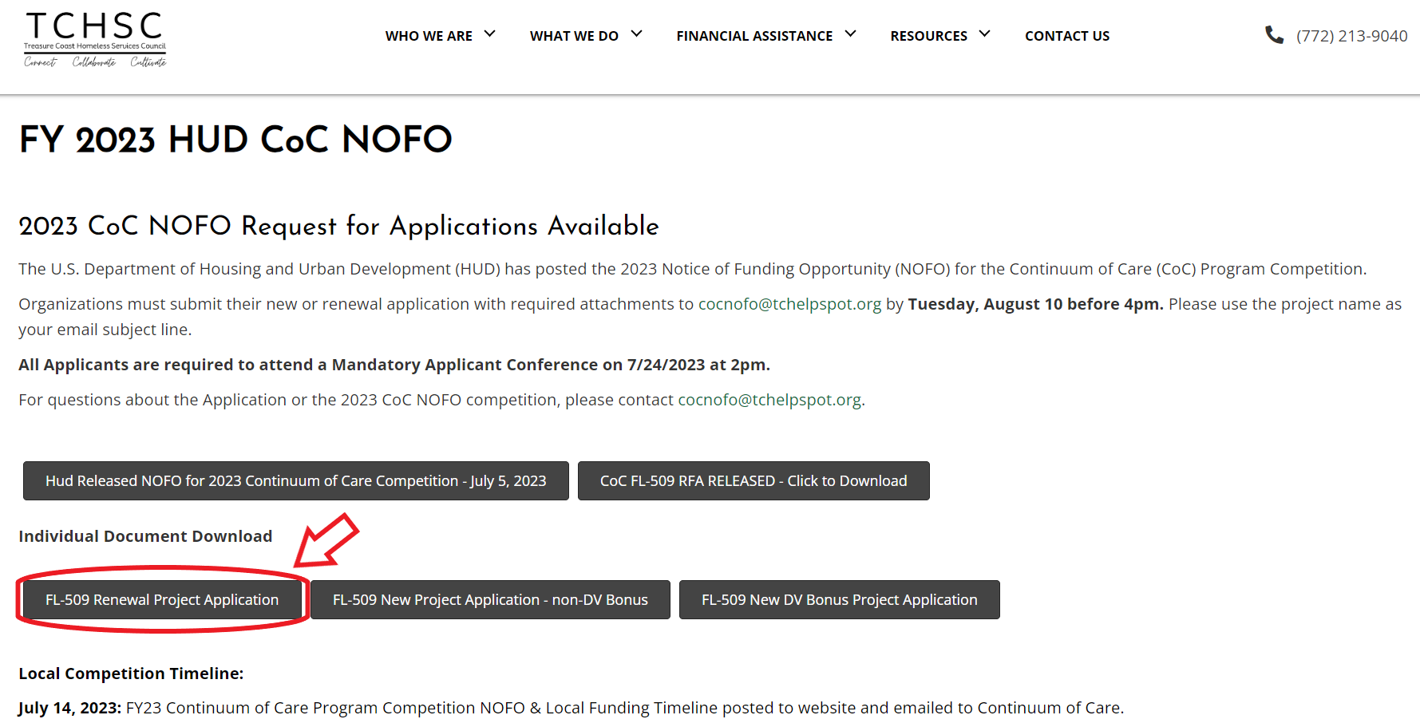

Slide 15
Renewal project scoring
Race Equity | 10
Timely Drawdowns and Recaptured Funds | 20
Project Performance | 70
Total | 100
Detailed Scoring Tool included in RFA

Slide 16
New projects

Slide 17
new project application
To request funding for a new project proposed for HUD CoC funding or an expansion of an existing HUD CoC-funded project
Two types of New Project Applications – choose the right one!
New DV Bonus Project Application
New Project Application other than DV Bonus Project
Download application from website
Submit to cocnofo@tchelpspot.org before 4:00pm on August 10

Slide 18
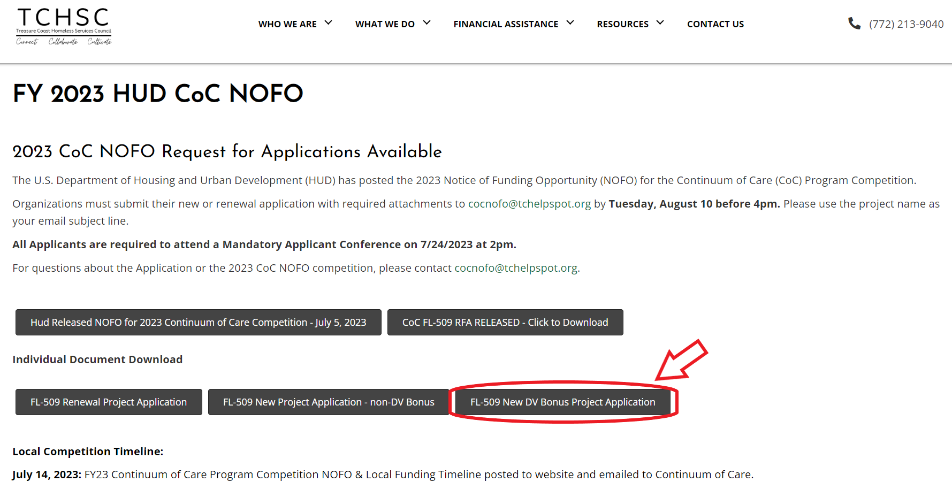

Slide 19
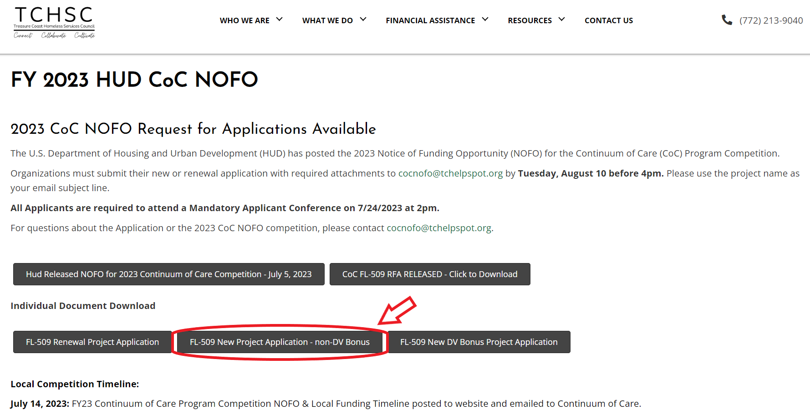

Slide 20
DV Bonus scoring tool
Section | RRH | CE
Org’al Capacity | 8 | 8
Overall Project Design | 21 | 21
Program Design | 12 | 25
Expected Performance | 43 | 40
Budget | 6 | 6
Housing First | 10 | -
Total | 100 | 100
Detailed Scoring Tool included in RFA

Slide 21
New project scoring tool (non-dv)
Org’al Capacity | 15
Project Design | 26
Expected Performance | 43
Budget | 6
Housing First | 10
Total | 100
Detailed Scoring Tool included in RFA

Slide 22
Process following your applications

Slide 23
Review, Scoring, Ranking
The Review and Rank Committee will use the published scoring tools to score each project application – including renewals and new projects
The Review and Rank Committee will determine:
Projects to be rejected
Projects to be submitted to HUD but at an amount less than the amount requested by the project applicant, which may include reallocating funding from existing projects
Projects to be submitted to HUD at the amount requested by the project applicant.
Ranks of each project to be submitted to HUD, apart from the CoC Planning grant, which is not subject to ranking as required by HUD
There is an appeals process outlined in the Request for Applications

Slide 24
E-snaps submissions
Projects accepted for inclusion in the CoC’s Consolidated Application to HUD will be entered into HUD’s online application system – e-snaps – by TCHSC
TCHSC will submit the following to HUD, as required by the NOFO, by September 28, 2023
New and renewal projects as entered into e-snaps
Project priority (ranked) list
CoC Application

Slide 25
Questions?

